Slide 1
Abrar Khan
Manu Kuchhal
September 05, 2014
Product Implementation Training (PIT)
IBM Case Manager v5.2.1
Upgrade Scenario 2
Upgrade from IBM Case Manager v5.1.1

Slide 2
Introduction
Course Overview
  This session covers the upgrade scenarios from ICM 5.1.1 to 5.2.1
Target Audience:
  IBM Case Manager Support Teams (L2,L3)
  ECM Lab Services
  IBM GBS and GTS
  Technical Sales
Prerequisites:
  Working knowledge of ICM 5.1.1, Content Navigator 2.0.3, and FileNet P8 5.2 architecture and implementation
Version Release Date: September, 2014
© Copyright International Business Machines Corporation 2013. All Rights Reserved.
US Government Users Restricted Rights - Use, duplication or disclosure restricted by GSA ADP Schedule Contract with IBM Corp.

Slide 3
Course Objectives
After this course you will be able to:
Understand the Case Manager upgrade process
Perform software upgrades of IBM Case Manager Development, Test and Production Environments
Migrate existing IBM Case Manager environments to new hardware as part of the upgrade process
Perform Solution and Template upgrades using Case Manager Builder
Understand the Best Practices guidelines pertaining to upgrades

Slide 4
Course Roadmap
  High Level Upgrade Overview
      Environment Upgrade
          Side-by-side upgrade
            Use existing hardware
            Move to new hardware
          In-place upgrade
            Use existing hardware
            Move to new hardware
      Solution Upgrade
      Best Practices
      Course Summary

Slide 5
High Level Upgrade Roadmap
1
Prepare existing Development, Test/UAT, and Production environments
2
Upgrade existing environments
3
Configure upgraded environments
4
Upgrade solutions
5
Migrate and deploy upgraded solutions to Test/UAT environments
6
Migrate and deploy validated solutions to Production

Slide 6
High Level Upgrade Roadmap – Upgrade Flowchart
Development Environment
Test / Production Environments
1. Install and configure ICM 5.2.1
5. Install and configure ICM 5.2.1
2. Upgrade business solution
6. Import and deploy business solution
Custom widgets/page layouts?
No
All solutions moved?
No
Yes
3. Convert custom iWidgets to Dojo
Yes
4. Customize page layouts
7. Final Cleanup

Slide 7
High Level Upgrade Roadmap – Side-by-side or In-place upgrade
Side-by-side Upgrade
New Design and Target object stores are required
New WebSphere profile required to deploy Content Navigator 2.0.3 and Case Manager 5.2.1 applications
Install ICM 5.2.1 in a new location
Both 5.1.1 and 5.2.1 versions of the business solution are accessible after upgrading the solution and deploying
Only Development environments are supported
In-place Upgrade
Re-use existing Design and Target object stores
New WebSphere profile required for Content Navigator 2.0.3 and Case Manager 5.2.1 applications even when upgrading on the same physical server
Install ICM 5.2.1 in a new location even when upgrading on the same physical server
Only the 5.2.1 version of the business solution is accessible after upgrading the solution and re-deploying
Development, Test/UAT, and Production environments are supported

Slide 8
Course Roadmap
  High Level Upgrade Overview
  Environment Upgrade
    Side-by-side upgrade
      Use existing hardware
      Move to new hardware
    In-place upgrade
      Use existing hardware
      Move to new hardware
  Solution Upgrade
  Best Practices
  Course Summary

Slide 9
Environment Upgrade – Prepare existing environment
The following operations must be performed on all existing Case Manager 5.1.1 environments before starting the upgrade process:
Upgrade all FileNet P8 5.1.x components to P8 5.2
Download and install the following fix packs from IBM Support Fix Central:
  Content Platform Engine 5.2.0 Fix Pack 3 (Release Date: Mar 12, 2014)
  Content Platform Engine 5.2.0.3 Interim Fix 3 (Release Date: Sep 05, 2014)
  WorkplaceXT 1.1.5.2 Interim Fix 1 (Release Date: Dec 23, 2013)
  Case Manager 5.1.1 Fix Pack 2 (Release Date: Oct 15, 2013)
Backup (full backup recommended) your existing environments

Slide 10
Development Environment – Side-by-side upgrade using existing hardware
Create new Design and Target object stores
Create a new WebSphere profile
Install and configure Content Navigator 2.0.3
Deploy Content Navigator application to the new WebSphere profile
Install and configure Case Manager 5.2.1 in a new location
Deploy all Case Manager applications to the new WebSphere profile
(Optional) Configure and deploy an instance of WorkplaceXT to the new WebSphere profile ¹
Migrate business solutions from 5.1.1 to 5.2.1 Design Object Store
Upgrade business solutions using Case Builder 5.2.1; customize page layouts (optional)
Convert, deploy and register any custom widgets and/or custom components
Deploy and test upgraded business solutions
WebSphere Application Server
ICM 5.1.1 Profile
Target Object Store 5.1.1
Workflow System
Case Client 5.1.1
Design Object Store 5.1.1
Business Space 7.5.1
Project Area
Solution 5.1.1
Case Builder 5.1.1
Solution 5.1.1
Design Object Store 5.2.1
8. Migrate
Project Area
Target Object Store 5.2.1
ICM 5.2.1 Profile
Workflow System
Case Builder 5.2.1
9. Upgrade
Solution 5.2.1
Solution 5.2.1
Content Navigator 2.0.3
10. Deploy
Upgraded Custom Widgets
11a. Deploy
Case Client 5.2.1
11b. Test
Notes:
If access to Process Designer is required from both Case Builder 5.2.1 and 5.1.1, configure and deploy another instance of WorkplaceXT to the new WebSphere profile, pointing to the new Target object store Connection point.

Slide 11
Development Environment – Side-by-side upgrade using existing hardware
Create a new Development profile using the Case Manager configuration tool and execute these tasks
Required tasks:
Update the Content Platform Engine Client Connector files
Note: The Case Manager configuration tool must be restarted after executing this task
Configure the Case Management Object Stores
Note: Run this task against all Target Object Stores
Define the default Project Area
Note: Use the Manage Project Areas option to create additional Project Areas
Create Case Manager Applications
Deploy the Case Manager API
Register the IBM Case Manager Services Plug-in
Deploy Workplace XT ²
Deploy Case Manager Builder
Deploy the Case Manager Help System
Deploy and Register Widgets Package
Register the IBM Case Manager Administration Client Plug-in
Register Project Area ³
Note: Run this task for all Project Areas
Optional tasks:
Deploy the Forms Application ¹
Configure Business Rules
Register the External Data Service
Deploy and Register Extensions Package
Notes:
If the business solutions contain eForms or IBM Forms, the Deploy Forms Applications task must be executed
If the existing instance of WorkplaceXT will be used for Case Manager 5.2.1, the EAR file must be re-deployed to include updates that support multi-user editing.
Restart the WebSphere/WebLogic application server after all tasks have been executed

Slide 12
Development Environment – Side-by-side upgrade with new hardware
Install and configure FileNet P8 5.2 + latest fix packs and WorkplaceXT 1.1.5.2 on new hardware
Create Design and Target object stores
Install and configure Content Navigator 2.0.3
Install and configure Case Manager 5.2.1
Convert, deploy and register any custom widgets and/or custom components
Export business solutions from 5.1.1 environment and import into 5.2.1 Design Object Store
Upgrade business solutions using Case Builder 5.2.1; customize page layouts (optional)
Deploy and test upgraded business solutions
WebSphere Application Server
Case Builder 5.2.1
Design Object Store 5.2.1
7. Upgrade
Project Area
Content Navigator 2.0.3
Solution 5.2.1
8a. Deploy
5. Deploy
Target Object Store 5.2.1
Workflow System
Case Manager administration client
5.2.1
Upgraded
Custom widgets
Solution 5.2.1
Case Client 5.2.1
Solution package
6. Import
8b. Test
Notes:
During the initial setup and configuragtion, it is a best practice to point to copies of the GCD and object store databases.
If the object stores use File Storage Areas, make sure you configure the new environment to point to the existing storage locations.
Before deploying the FileNetEngine EAR file in the new environment, you must transfer the encryption keys from the EAR file in the existing environment. Alternately, you can copy the entire EAR file from the existing environment and deploy it using the FieNet Configuration Manager.

Slide 13
Development Environment – Side-by-side upgrade with new hardware
Create a new Development profile using the Case Manager configuration tool and execute these tasks
Required tasks:
Update the Content Platform Engine Client Connector files
Note: The Case Manager configuration tool must be restarted after executing this task
Configure the Case Management Object Stores
Note: Run this task against all Target Object Stores
Define the default Project Area
Note: Use the Manage Project Areas option to create additional Project Areas
Create Case Manager Applications
Deploy the Case Manager API
Register the IBM Case Manager Services Plug-in
Deploy Workplace XT
Deploy Case Manager Builder
Deploy the Case Manager Help System
Deploy and Register Widgets Package
Register the IBM Case Manager Administration Client Plug-in
Register Project Area ²
Note: Run this task for all Project Areas
Optional tasks
Deploy the Forms Application ¹
Configure Business Rules
Register the External Data Service
Deploy and Register Extensions Package
Notes:
If the business solutions contain eForms or IBM Forms, the Deploy Forms Applications task must be executed
Restart the WebSphere/WebLogic application server after all tasks have been executed

Slide 14
Development Environment – In-place upgrade using existing hardware
Reuse existing Design and Target object stores
Create a new WebSphere profile
Install and configure Content Navigator 2.0.3
Deploy Content Navigator application to the new WebSphere profile
Install and configure Case Manager 5.2.1 in a new location
Deploy all Case Manager applications to the new WebSphere profile
Upgrade business solutions using Case Builder 5.2.1; customize page layouts (optional)
Convert, deploy and register any custom widgets and/or custom components
Deploy and test upgraded business solutions
WebSphere Application Server
ICM 5.2.1 Profile (new)
Target Object Store
Workflow System
Case Builder 5.2.1
Design Object Store
Solution 5.1.1
7. Upgrade
Project Area
Project Area
Content Navigator 2.0.3
Solution 5.2.1
Solution 5.1.1
Case Client 5.2.1
Upgraded Custom Widgets
Solution 5.2.1
9a. Deploy
9b. Test

Slide 15
Development Environment – In-place upgrade using existing hardware
Create a new Development profile using the Case Manager configuration tool and execute these tasks
Required tasks:
Update the Content Platform Engine Client Connector files
Note: The Case Manager configuration tool must be restarted after executing this task
Configure the Case Management Object Stores
Note: Run this task against all Target Object Stores
Create Case Manager Applications
Deploy the Case Manager API
Register the IBM Case Manager Services Plug-in
Deploy Workplace XT ²
Deploy Case Manager Builder
Deploy the Case Manager Help System
Deploy and Register Widgets Package
Register the IBM Case Manager Administration Client Plug-in
Register Project Area ³
Note: Run this task for all Project Areas
Optional tasks
Deploy the Forms Application ¹
Configure Business Rules
Register the External Data Service
Deploy and Register Extensions Package
Notes:
If the business solutions contain eForms or IBM Forms, the Deploy Forms Applications task must be executed
The WorkplaceXT application must be re-deployed to include support for multi-user editing in Case Builder.
Restart the WebSphere/WebLogic application server after all tasks have been executed

Slide 16
Development Environment – In-place upgrade with new hardware
Install and configure FileNet P8 5.2 + latest fix packs and WorkplaceXT 1.1.5.2 on new hardware
Note: Configure JDBC Data Sources to point to existing GCD and object store databases ¹
Install and configure Content Navigator 2.0.3
Install and configure Case Manager 5.2.1
Convert, deploy and register any custom widgets and/or custom components
Export business solutions from 5.1.1 environment and import into 5.2.1 Design Object Store
Upgrade business solutions using Case Builder 5.2.1; customize page layouts (optional)
Deploy and test upgraded business solutions
WebSphere Application Server
Case Builder 5.2.1
Design Object Store 5.2.1
7. Upgrade
Project Area
Content Navigator 2.0.3
Solution 5.2.1
8a. Deploy
5. Deploy
Target Object Store 5.2.1
Workflow System
Case Manager administration client
5.2.1
Upgraded Custom widgets
Solution 5.2.1
Case Client 5.2.1
Solution package
6. Import
8b. Test
Notes:
During the initial setup and configuragtion, it is a best practice to point to copies of the GCD and object store databases.
If the object stores use File Storage Areas, make sure you configure the new environment to point to the existing storage locations.
Before deploying the FileNetEngine EAR file in the new environment, you must transfer the encryption keys from the EAR file in the existing environment. Alternately, you can copy the entire EAR file from the existing environment and deploy it using the FieNet Configuration Manager.

Slide 17
Development Environment – In-place upgrade with new hardware
Create a new Development profile using the Case Manager configuration tool and execute these tasks
Required tasks:
Update the Content Platform Engine Client Connector files
Note: The Case Manager configuration tool must be restarted after executing this task
Configure the Case Management Object Stores
Note: Run this task against all Target Object Stores
Create Case Manager Applications
Deploy the Case Manager API
Register the IBM Case Manager Services Plug-in
Deploy Workplace XT
Deploy Case Manager Builder
Deploy the Case Manager Help System
Deploy and Register Widgets Package
Register the IBM Case Manager Administration Client Plug-in
Register Project Area ²
Note: Run this task for all Project Areas
Optional tasks
Deploy the Forms Application ¹
Configure Business Rules
Register the External Data Service
Deploy and Register Extensions Package
Notes:
If the business solutions contain eForms or IBM Forms, the Deploy Forms Applications task must be executed
Restart the WebSphere/WebLogic application server after all tasks have been executed

Slide 18
Test/Production Environment – In-place upgrade using existing hardware
Reuse existing Staging and Target Object Stores
Create a new WebSphere profile
Install and configure Content Navigator 2.0.3
Deploy Content Navigator application to the new WebSphere profile
Install and configure Case Manager 5.2.1 in a new location
Deploy all Case Manager applications to the new WebSphere profile
Migrate upgraded business solutions from Development environment to Staging Object Store
Migrate and deploy any custom widgets and/or custom components
Deploy and test upgraded business solutions
WebSphere Application Server
ICM 5.1.1 Profile
Target Object Store
Workflow System
Business Space 7.5.1
Solution 5.1.1
Case Client 5.1.1
Staging Object Store
Upgraded Solution Package
7. Import
Target Environment 5.1.1
Solution 5.2.1
ICM 5.2.1 Profile
Solution 5.1.1
Case Manager Admin Client
Content Navigator 2.0.3
Target Environment 5.2.1
Case Client 5.2.1
Upgraded Custom Widgets
Solution 5.2.1
9a. Deploy
8. Deploy
9b. Test

Slide 19
Test/Production Environment – In-place upgrade using existing hardware
Create a new Production profile using the Case Manager configuration tool and execute these tasks
Required tasks:
Update the Content Platform Engine Client Connector files
Note: The Case Manager configuration tool must be restarted after executing this task
Configure the Case Management Object Stores
Note: Run this task against all Target Object Stores
Define Target Environment
Note: Re-run this task to create multiple Target Environments
Create Case Manager Applications
Deploy the Case Manager API
Register the IBM Case Manager Services Plug-in
Deploy the Case Manager Help System
Deploy and Register Widgets Package
Register the IBM Case Manager Administration Client Plug-in
Register Target Environment ²
Note: Run this task for all Target Environments
Optional tasks:
Deploy the Forms Application ¹
Configure Business Rules
Register the External Data Service
Deploy and Register Extensions Package
Notes:
If the business solutions contain eForms or IBM Forms, the Deploy Forms Applications task must be executed
Restart the WebSphere/WebLogic application server after all tasks have been executed

Slide 20
Test/Production Environment – In-place upgrade with new hardware
Install and configure FileNet P8 5.2 + latest fix packs on new hardware
Note: Configure JDBC Data Sources to point to existing GCD and object store databases ¹
Install and configure Content Navigator 2.0.3
Install and configure Case Manager 5.2.1
Migrate and deploy any custom widgets and/or custom components
Export upgraded business solutions from Case Manager 5.2.1 Development environment
Import business solutions into new Case Manager 5.2.1 environment
Deploy and validate business solutions in the new environment
Case Manager 5.2.1 Development Environment
Case Manager 5.2.1 Test/Production Environment
Websphere Application Server
Design Object Store
Staging Object Store
Target Object Store
Business Space 7.5.1
Workflow System
Case Client 5.1.1
Target Environment 5.1.1
Solution 5.1.1
Solution 5.1.1
Upgraded Solution
WebSphere Application Server (new hardware)
Upgraded Solution
Target Environment 5.2.1
Solution 5.2.1
7b. Validate
Case Client 5.2.1
Solution 5.2.1
Content Navigator 2.0.3
5. Export
7a. Deploy
Solution Package
Upgraded
Custom Widgets
6. Import
4. Import
Notes:
During the initial setup and configuragtion, it is a best practice to point to copies of the GCD and object store databases.
If the object stores use File Storage Areas, make sure you configure the new environment to point to the existing storage locations.
Before deploying the FileNetEngine EAR file in the new environment, you must transfer the encryption keys from the EAR file in the existing environment. Alternately, you can copy the entire EAR file from the existing environment and deploy it using the FieNet Configuration Manager.

Slide 21
Test/Production Environment – In-place upgrade with new hardware
Create a new Production profile using the Case Manager configuration tool and execute these tasks
Required tasks:
Update the Content Platform Engine Client Connector files
Note: The Case Manager configuration tool must be restarted after executing this task
Configure the Case Management Object Stores
Note: Run this task against all Target Object Stores
Define Target Environment
Note: Re-run this task to create multiple Target Environments
Create Case Manager Applications
Deploy the Case Manager API
Register the IBM Case Manager Services Plug-in
Deploy the Case Manager Help System
Deploy and Register Widgets Package
Register the IBM Case Manager Administration Client Plug-in
Register Target Environment ²
Note: Run this task for all Target Environments
Optional tasks:
Deploy the Forms Application ¹
Configure Business Rules
Register the External Data Service
Deploy and Register Extensions Package
Notes:
If the business solutions contain eForms or IBM Forms, the Deploy Forms Applications task must be executed
Restart the WebSphere/WebLogic application server after all tasks have been executed

Slide 22
Course Roadmap
  High Level Upgrade Overview
  Environment Upgrade
    Side-by-side upgrade
      Use existing hardware
      Move to new hardware
    In-place upgrade
      Use existing hardware
      Move to new hardware
  Solution Upgrade
  Best Practices
  Course Summary

Slide 23
Solution Upgrade – High-level Overview
Solution Upgrade from ICM 511 to ICM 521
Solution Template upgrade from ICM 511 to ICM 521 is not supported

Slide 24
Solution Upgrade – High-level Overview
Solution upgrade from ICM 511 to ICM 521
SDF is converted to ICM 5.2.1 schema
  PE configuration file is updated
  ICM solution 5.2.1 structure is created
  Out of the box ICM 5.2.1 web application is generated
  The solution can be deployed

Slide 25
Solution Upgrade – Background
IBM Case Manager(ICM) 5.2.1 has several structural changes to a Solution Package. Some of the major changes are:
  Inclusion of Page Objects along with their content within Solution Package
  Separation of Data Views as independent artifacts outside SDF
  Enablement for Multi-user editing capabilities i.e., inclusion of Draft/Lock Objects within Solution Package
  Extra properties defined on Solution folder

Slide 26
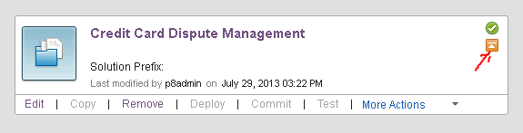
Solution Upgrade – Upgrade overview using Case Builder
Its assumed that Solution is already exported from a 5.1.1 project area and imported into a 5.2.1 project area; either in same (in-place upgrade) or different (side-by-side upgrade) P8 domain
A 5.1.1 solution can be distinguished from a 5.2.1 solution by:
  A distinct orange icon appears on top right corner that goes off after upgrade
  Solution Prefix is empty
  Actions for Copy, Deploy, Commit and Test are disabled

Slide 27
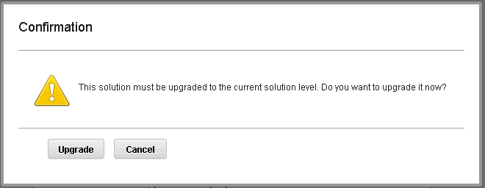
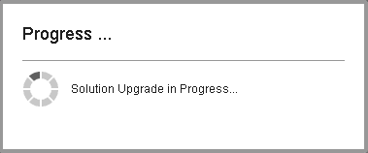
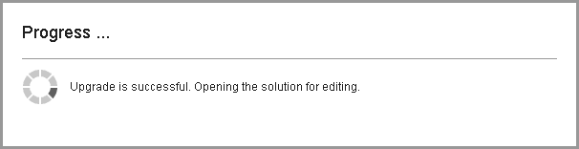
Solution Upgrade – Upgrade overview using Case Builder
Clicking on the Edit action for a 5.1.1 solution opens the option to upgrade.
Once the user chooses to Upgrade, system prompts keep the user informed about the progress of the upgrade.

Slide 28
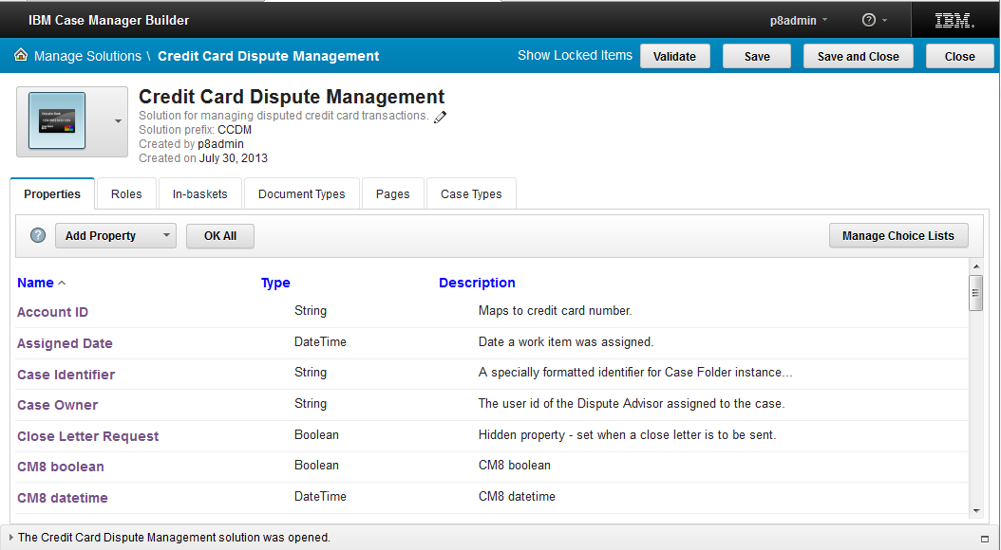
Solution Upgrade – Upgrade overview using Case Builder
If the upgrade completes successfully, the solution is opened for editing. And the solution can be edited just like any other 5.2.1 solution ¹
Notes:
The upgrade failure scenarios are discussed from Slide 43 onwards.

Slide 29
Solution Upgrade – Deep Dive into upgrade of solution artifacts
At a high level, the upgrade of an ICM 5.1.1 solution 5.2.1 involves the following steps:
    Update of the SDF, PEConfig, Pages and Views.
    Inclusion of Multi-user related artifacts.
    Miscellaneous changes: rename of xpdl, new properties on Solution folder, etc.
The upgrade is performed as a single transaction. In the event of a failure, all changes are reverted and the solution is restored to the 5.1.1 version.
The migration of custom pages and conversion of custom iWidgets to Dojo is an iterative exercise that needs to be done manually.
In next few slides, we will take a deep dive into the kind of changes that are done during update, including each one of the above mentioned artifacts.
Notes:
The upgrade failure scenarios are discussed from Slide 43 onwards.

Slide 30
Solution Upgrade – Update of SDF
Update the solution definition file (SDF) to ICM Magellan schema
  Modify the schema version: <sdf:schemaVersion>3.1</sdf:schemaVersion>
  Modify the product version: <sdf:productVersion>5.2.1</sdf:productVersion>
Update of Case Data Views also impacts the SDF
Notes:
The upgrade failure scenarios are discussed from Slide 43 onwards.

Slide 31
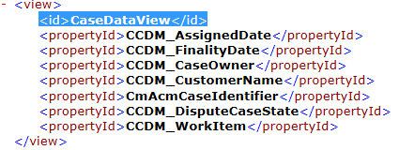
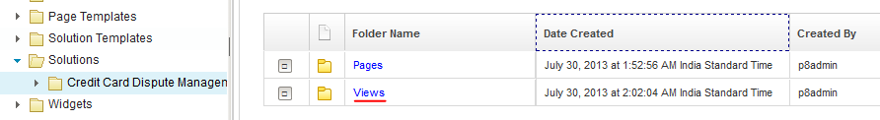

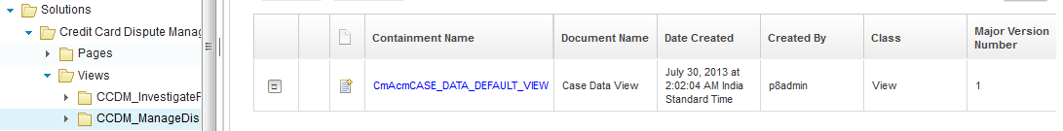
Solution Upgrade – Update of Views
Starting in ICM 5.2.0, Case Data Views were removed from the SDF. For each case type in the SDF, the update process removes the Case Data View section and a separate Views artifact is created in the Solution Package
Views folder created under the Solution folder
Separate case level folder created under the Views folder
View created under CaseType

Slide 32
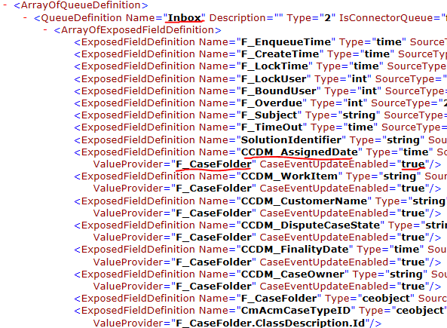
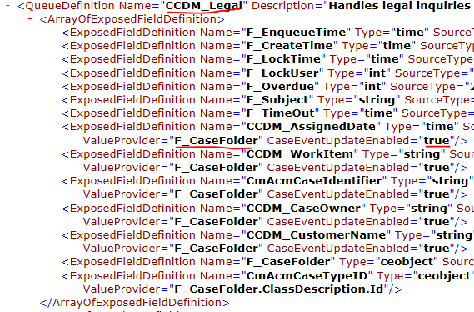
Solution Upgrade – Update Process Engine Configuration
To support data synchronization between the in-basket work item properties and the case properties, the following steps and done by the Case Builder during the upgrade process:
Expose F_CaseFolder for the solution roster (already done for ICM 5.1.1)
Expose F_CaseFolder in all role queues and Inbox
For each exposed field that is also a case property, these values are set:
Using PE API, set ValueProvider to F_CaseFolder
ValueProvider = “F_CaseFolder”
Using PE API, set CaseEventUpdateEnable to true
CaseEventUpdateEnabled = “true”

Slide 33
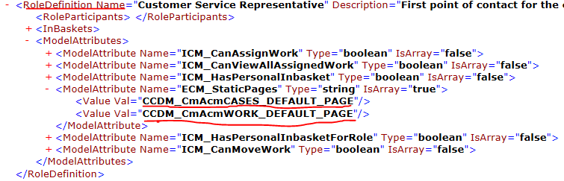
Solution Upgrade – Update of PE Configuration
For each role definition within PE configuration file, Case Builder adds a new Model Attribute which is a multi-value string array of Page names
Case Builder ensures that the values/page identifier entered in the model attribute of a role definition is consistent
  with the name/page identifier in the SDF
  in the Step Processor Info Definition entry in the PE configuration file

Slide 34
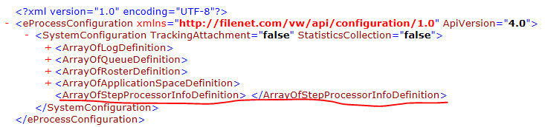
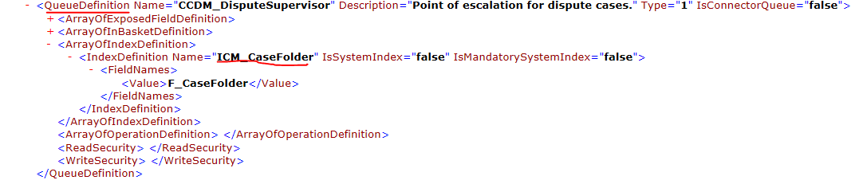
Solution Upgrade – Update of PE Configuration
Removes the value of the parameter - StepProcessorInfoDefinition
Note: Post upgrade the given element is empty.
Creates the index for ICM_CaseFolder in the Roster Definition of the solution.
  Under ArrayOfRosterDefinition/RosterDefinition an element i.e., <IndexDefinition> is added with the Name = 'ICM_CaseFolder'

Slide 35
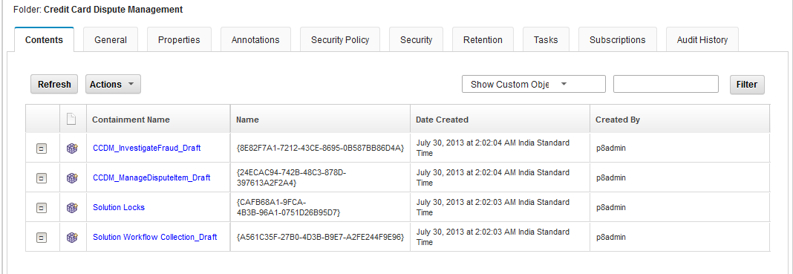
Solution Upgrade – Enablement of Multi-user editing features
During upgrade of a ICM 5.1.1 solution, the following additional artifacts are created in the solution folder to enable the multi-user editing:
  Lock Object
  Draft Areas for CaseTypes and Global Workflow Collection

Slide 36
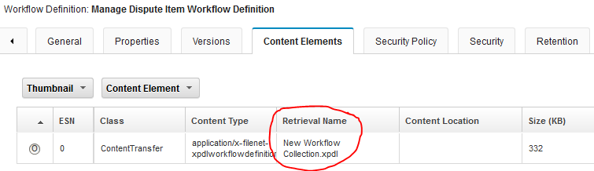
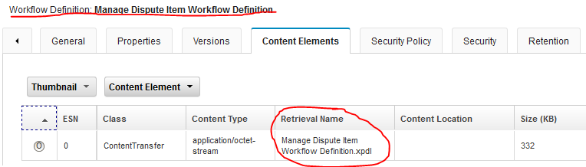
Solution Upgrade – Miscellaneous changes to Solution Package
Case Builder updates the content element’s retrieval name of the case type workflow definition to <DocumentTitle>+”.xpdl”.
Pre Upgrade:
Post Upgrade:

Slide 37
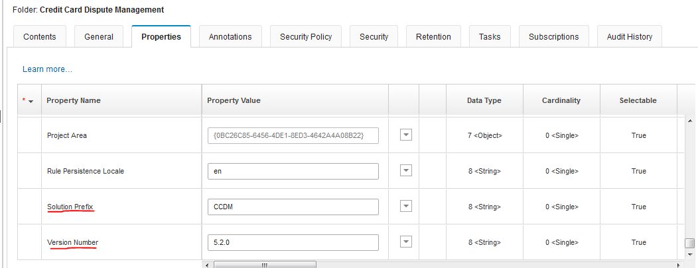
Solution Upgrade – Miscellaneous changes to Solution Package
Enable extra properties on solution folder after a successful upgrade:
  Solution Prefix (CmAcmSolutionPrefix)
  Version Number (CmAcmVersionNumber)

Slide 38
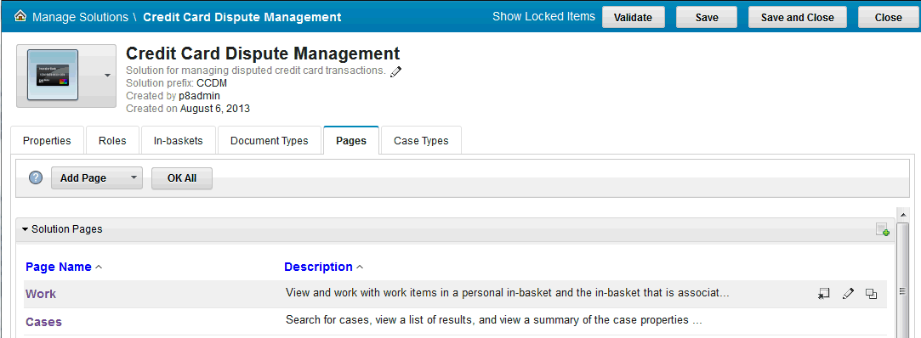
Solution Upgrade – Update of Pages
The Pages features have undergone major revamp in Case Manager 5.2.x
Starting in Case Manager 5.2, Case Builder is providing a convenient interface to add, modify and delete the pages in a solution

Slide 39
Solution Upgrade – Default Pages and Custom Pages
Pages get updated as soon as a a 5.1.1 solution is opened in Case Builder 5.2.1
Update of Default Pages by Case Builder:
  Creates or Updates a fresh list of default pages documents under the Pages Folder
  Adds a new property CmAcmReference to existing page documents
  Unlike previous versions, contents of Pages are also stored in these page documents within the Content Engine
  During the upgrade, existing content of the Pages (stored in BSpace) is not carried over, but is replaced by default content

Slide 40
Solution Upgrade – Default Pages and Custom Pages
Upgrade of Custom Pages by the Case Builder is similar to the default pages
  Update the page object of Custom Pages
  Add a new property CmAcmReference
  Unlike previous versions, contents of Pages are also stored in these page documents within the Content Engine
  During the upgrade, existing content of the Pages (stored in BSpace) is not carried over but is replaced by default content
  For Custom Form Pages, the content is populated from the templates of non-Form Pages of that category
As a post upgrade step users may want to:
  Customize the default content of the pages
  Re-create lost static pages from Solution/custom spaces and assign them to the Roles

Slide 41
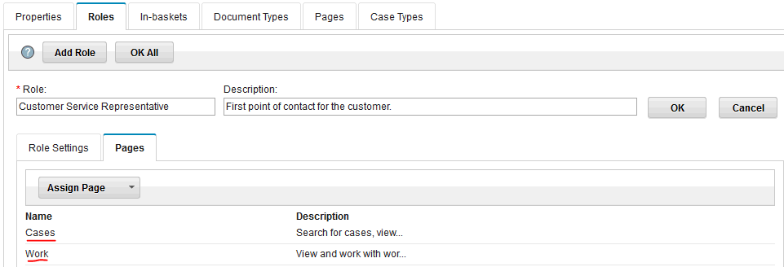
Solution Upgrade – Default Static Pages Created
The upgrade process creates the following OOTB default static pages of type -1 (this is the new page type)
  CmAcmWORK_DEFAULT_PAGE (for “Work” tab) and CmAcmCASES_DEFAULT_PAGE (for “Cases” tab)
  By default these pages are assigned to all Roles in the solution
All other static pages in the solution are discarded. Additional static pages can be created using Page Designer

Slide 42
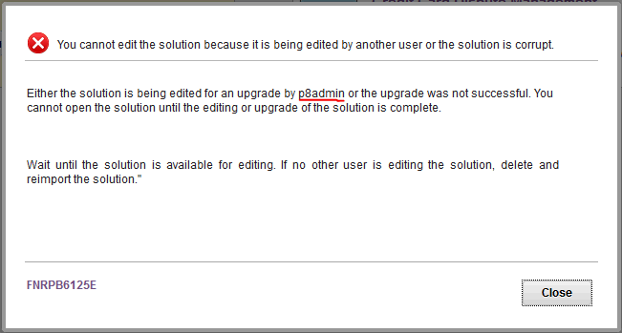
Solution Upgrade - Exceptional Flows and Troubleshooting – 1 of 3
This section discusses about some exceptional flows and the troubleshooting steps if the upgrade of a solution is not successful.
When a user chooses to Upgrade a Solution, there can be multiple reasons why the upgrade might fail
Either another user (underlined) is in the process of upgrading the same solution or the upgrade had failed when other user (underlined) had tried to upgrade it. ¹
Notes:
Instructions are already provided in the dialogue box. I.e either contact the user who is already working on that solution. Incase that user is not working and solution upgrade had failed then delete and try the process again.

Slide 43
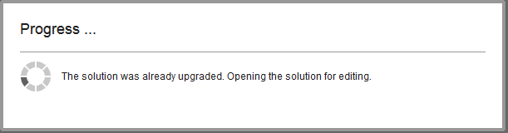
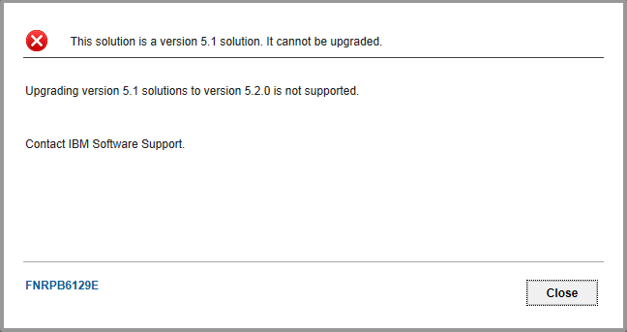
Solution Upgrade - Exceptional Flows and Troubleshooting – 2 of 3
This indicates that another user’s upgrade action was completed before request from this user was executed
Solution upgrades from 5.1 to 5.2.1 are not supported

Slide 44
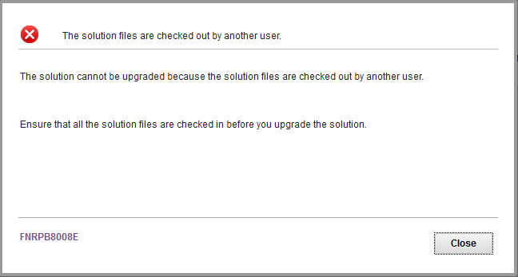
Solution Upgrade - Exceptional Flows and Troubleshooting – 3 of 3
The upgrade will also fail if the solution documents are checked out by another user

Slide 45
Course Roadmap
  High Level Upgrade Overview
  Environment Upgrade
    Side-by-side upgrade
      Use existing hardware
      Move to new hardware
    In-place upgrade
      Use existing hardware
      Move to new hardware
  Solution Upgrade
  Best Practices
  Course Summary

Slide 46
Best Practices
Environment and solution backups
  Always perform a full backup of the Case Manager environment after applying the latest fix packs and before starting the upgrade process.
  Business solutions and all related artifacts should also be exported and backed-up before the upgrade.
Network Shared Directory
  Always use a SAN/NAS/NFS location as the network shared directory.
  The network shared directory should never be shared with any other instance of Case Manager.
Deploying custom widgets and extensions packages
  Use these Case Manager configuration tool tasks to deploy and register custom widget packages and extension packages.
    Deploy and Register Widgets Package
    Deploy and Register Extensions Package

Slide 47
Best Practices
Version control business solutions
  When migrating business solutions between environments e.g., Development to Test / Production, it is recommended to version control the solution package and all other related artifacts.
Exporting business solutions
  Don't export business solutions from a Test / UAT environment when migrating to Production
  Always use the solution exported from the Development environment to migrate a solution to Production

Slide 48
Course Roadmap
  High Level Upgrade Overview
  Environment Upgrade
    Side-by-side upgrade
      Use existing hardware
      Move to new hardware
    In-place upgrade
      Use existing hardware
      Move to new hardware
  Solution Upgrade
  Best Practices
  Course Summary

Slide 49
Course Summary
You have completed this course and can:
Perform software upgrades of IBM Case Manger Development, Test and Production Environments
Migrate IBM Case Manager environments to new hardware as part of the upgrade process
Perform Solution and Template upgrades using Case Manager Builder
Follow the Best Practices guidelines pertaining to upgrades

Slide 50
Contacts
Product Marketing Manager:
    William D. (Doc) Mills (wdocmills@us.ibm.com)
Product Manager:
    Dave Perman (dperman@ca.ibm.com)
Subject Matter Experts (SME)/Area of Expertise:
    Manu Kuchhal (manukuchhal@in.ibm.com)
    Paul Mac Alpine (psmacalp@us.ibm.com)
    Steven Hsieh (shsieh@us.ibm.com)
    Abrar Khan (abrakhan@us.ibm.com)
Product Support Manager:
    Ted Dullanty (tdullanty@us.ibm.com)

Slide 51
Product Help/Documentation/Resources
IBM Case Manager 5.2.1 Knowledge Center: http://www-01.ibm.com/support/knowledgecenter/SSCTJ4_5.2.1/com.ibm.casemgmttoc.doc/casemanager_5.2.1.htm?lang=en
IBM Case Manager 5.2 Knowledge Center:http://www-01.ibm.com/support/knowledgecenter/SSCTJ4_5.2.0/com.ibm.casemgmttoc.doc/casemanager_5.2.0.htm?lang=en
IBM Content Navigator 2.0.3 Knowledge Center:http://www-01.ibm.com/support/knowledgecenter/SSEUEX_2.0.3/com.ibm.usingeuc.doc/euche001.dita?lang=en
IBM FileNet P8 5.2 Knowledge Center: http://www-01.ibm.com/support/knowledgecenter/SSNW2F_5.2.0/com.ibm.p8toc.doc/filenetcontentmanager_5.2.0.htm?lang=en
IBM Support: Fix Central:
http://www-933.ibm.com/support/fixcentral/
ECM Learner Portal:
http://eb90.elearn.ihost.com/wps/portal/ibm
IBM FileNet Content Manager and IBM Case Foundation V5.2 Product Implementation and Maintenance Training (PIT/PMT) (220234)
IBM Case Manager V5.2 Product Implementation and Maintenance Training (PIT/PMT) (220246)

